Slide 1


Step Functions
GLOBAL SOFTWARE CONSULTANCY
Alejandro Pérez Batanero alejandro.batanero@thoughtworks.com
© 2020 ThoughtWorks

Slide 2

Solving an Issue
The hard way (simplified version)
Do the code
Create the branch in upstream
Notify reviewers
Gets approvals
Merge to master
Create Release
Notify Devops
© 2020 ThoughtWorks

Slide 3

WHAT? Orchestration
Ordering
Choice (branching)
Parallelization
Scale (Multi threads)
© 2020 ThoughtWorks

Slide 4
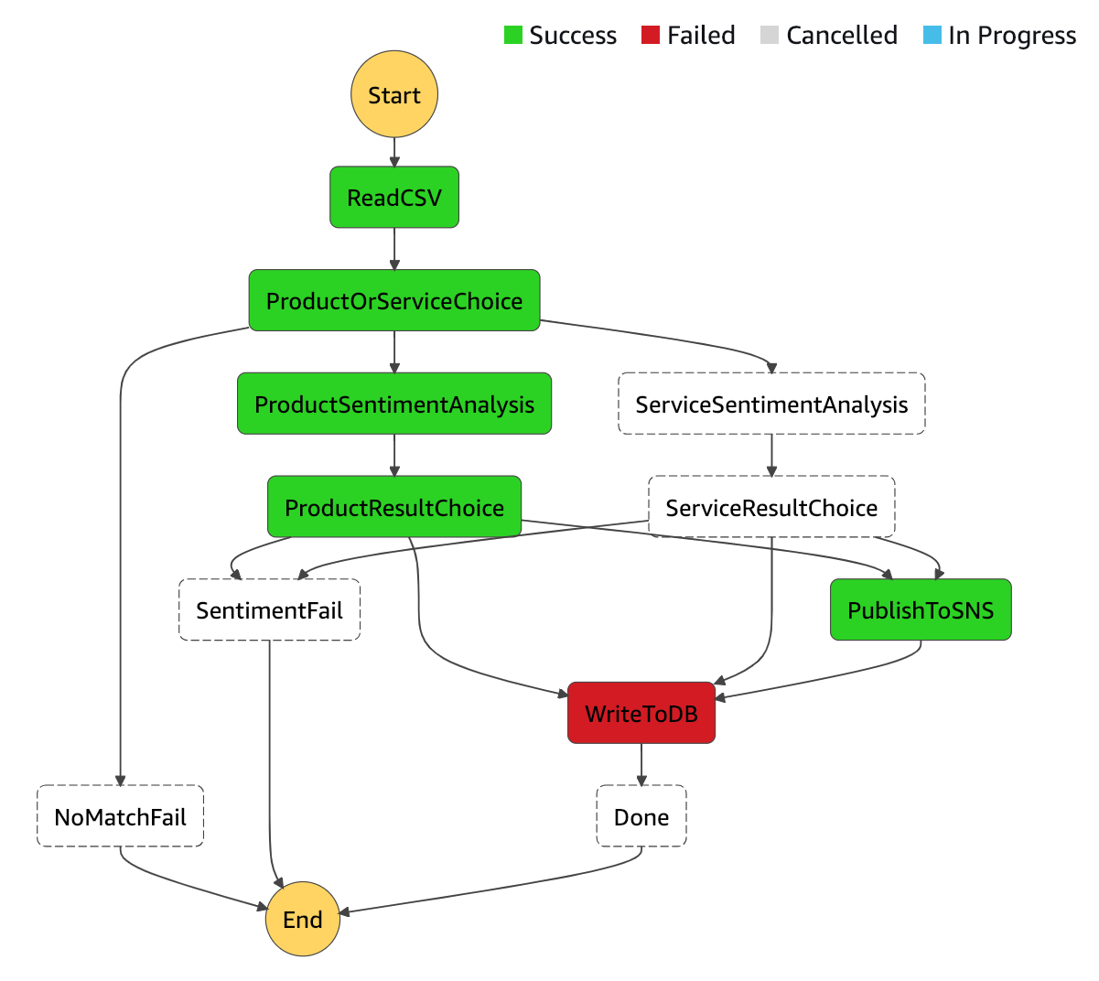
WHAT? Monitoring
Visualization
Error handling
Retries
Errors based choices
© 2020 ThoughtWorks

Slide 5

THE STATE MACHINE
Step Functions
© 2020 ThoughtWorks

Slide 6
State Machine
Amazon States Language (JSON)
{
"Comment": "An example that adds two numbers together.",
"StartAt": "Add",
"Version": "1.0",
"TimeoutSeconds": 10,
"States":
{
"Add": {
"Type": "Task",
"Resource": "arn:aws:lambda:us-east-1:123456789012:function:Add",
"End": true
}
}
}

Slide 7
State Machine
States
Pass
Task
Choice
Wait
End statuses (Succeed and Fail)
Parallel
Map

Slide 8
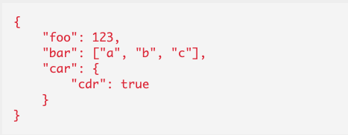
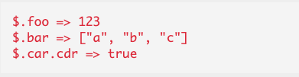
State Machine
Input & Output
Reference Paths
So:

Slide 9
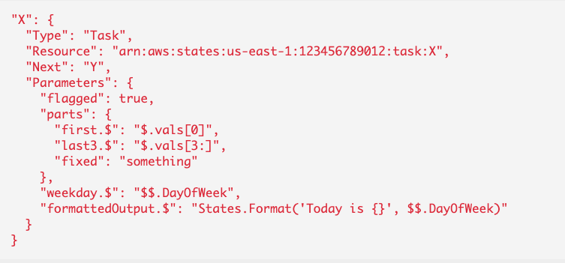
State Machine
Payload
Field name suffix .$ and value prefix $. => Path reference
Field name suffix .$ and value prefix $$. => Context Object
Field name suffix .$ => Value must be a Intrinsic Function

Slide 10
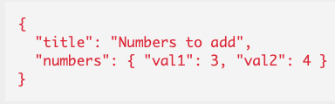
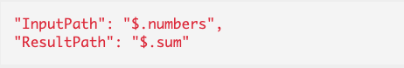
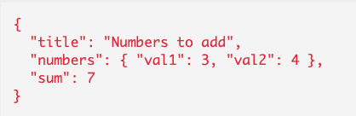
State Machine
Input & Output processing
InputPath => Extract Payload from Raw input
Parameters => Generate Payload using a JSON Object (Based on InputPath result)
ResultPath => Integrate raw output into raw input
OutputPath => Extract from effective result
Notes:
reject

Slide 11
PRACTICE!

Slide 12
Service Integrations
AWS Lambda
Run an AWS Batch job and then perform different actions based on the results.
Insert or get an item from Amazon DynamoDB.
Run an Amazon Elastic Container Service (Amazon ECS) task and wait for it to complete.
Publish to a topic in Amazon Simple Notification Service (Amazon SNS).
Send a message in Amazon Simple Queue Service (Amazon SQS).
Manage a job for AWS Glue or Amazon SageMaker..
Launch an AWS Step Functions workflow execution.
© 2020 ThoughtWorks

Slide 13
Pros & Cons
Pros
Modular
More functional style
Very extensible
Do once, use many
Efficient parallel executions
Gives Stateless to the functions
If you can see it, you can understand it

Slide 14
Pros & Cons
Cons
AWS privative
Business logic out of code
Learning curve

Slide 15
Resources
AWS Step Functions - The Ultimate Guide
How to manage your AWS Step Functions with Serverless
Amazon States Language
Input and Output Processing in Step Functions - AWS Step Functions
Context Object - AWS Step Functions
Intrinsic functions - AWS Step Functions
Deploying an Example Human Approval Project - AWS Step Functions
Service Integration Patterns - AWS Step Functions
© 2020 ThoughtWorks

Slide 16

THANKYOU
ALEJANDRO PEREZ Senior Consultant
alejandro.batanero@thoughtworks.com | thoughtworks.com
© 2020 ThoughtWorks

